Slide 1


CIS 280 System Analysis & Design
Team 5: Andrea, Jason, Steve

Slide 2
“If you fail to plan, you plan to fail”
- Professor Huitsing

Slide 3





PREPLANNING/ FEASIBILITY ANALYSIS

Slide 4
MISSION STATEMENT AND GOALS EDI ENROLLMENT QUEUE
MISSION STATEMENT
To deliver continued exceptional healthcare while leading the industry into a smarter future.
GOALS
Reduce time to receive payments
Reduction in manhours processing payments
More accurate records
Increase payment reconciliation time
Decrease enrollment time
Automate EDI enrollment identification

Slide 5
SWOT ANALYSIS
STRENGTHS
Experienced Team
Industry knowledge
Leadership and communication skills
OPPORTUNITIES
Growing market
Technology
Changes in business model
WEAKNESSES
Poor communication
Lack of commitment
Poor stakeholder involvement
THREATS
Changes in governance
Regulation adherence
Information security
KEY CONCEPTS FROM THIS ANALYSIS:
-Allowed us to evaluate where our assets lie.
-Gave the team a better understanding of the team dynamics
-Offered a chance for us to work outside of our comfort zone allowing for a lot of growth both as a team and as individuals
-This was a great experience but brief. We would like more practice using this analysis tool.

Slide 6
UNDERSTAND OPPORTUNITY
Our current business profile is an established dialysis company with multiple facilities across the country, who has recently started using Electronic Data Interchange(EDI). EDI includes electronic claims submission(ECS), electronic funds transfer(EFT) and electronic remittance advices(ERA). Each facility receives payment from multiple insurance companies by paper checks and paper explanation of benefits(EOB) or a remittance advice(RA) via postal mail. The company is enrolled for ECS however each facility needs to be enrolled with each insurance company to receive EFT and ERA. Currently, the enrollment opportunity is not identified until 30-45 days after a patient has been seen when payment is received via paper check and paper remittance. The cash then forwards that EOB to the EDI enrollment team. The EDI enrollment team then enters the info into their tracking sheet and enrolls the facility for either ERA, EFT or both with that insurance company. The EDI team then looks up to see if there are current pending claims from that facility to the payer and makes note to follow-up to verify if it is paid electronically or by paper. Automating the identification of the enrollment opportunity at the earliest point possible will not only help the cash applications and the EDI enrollment team procedurally but will benefit the Dialysis company ultimately reducing resources and increasing revenue. Implementing the proposed changes will reduce errors, increase productivity, expedite account updates, reduce delayed payments, decrease processing time, decrease number of open claims by end of month.
Impacted most would be the EDI enrollment team and the cash applications team.
KEY CONCEPTS FROM THIS ANALYSIS:
-Details the current system and procedures to better define current opportunities
-Provides direction and clear goal for project development
-Defines how development and implementation of the project will impact our specific business model.
-Through understanding of the opportunity, we can start to see other opportunities for growth

Slide 7
DEFINE PROJECT SCOPE
SCOPE:
To build a robust work-queue that will populate with enrollment opportunities that are automatically identified at the time the patient registers for their appointment at the individual facility. This will involve the Analyst team to review current systems and processes. The IT team to create code and build the Robust WQ. The EDI enrollment team to interview for needs and wants. We will also test the product for efficiency and profitability to keep on schedule and budget.
KEY CONCEPTS FROM THIS ANALYSIS:
-Defines the overall project from opportunity to goal
-Offered an opportunity to examine our project and be specific as to how it will function
-Requires a comprehensive understanding of the opportunity and current system

Slide 8
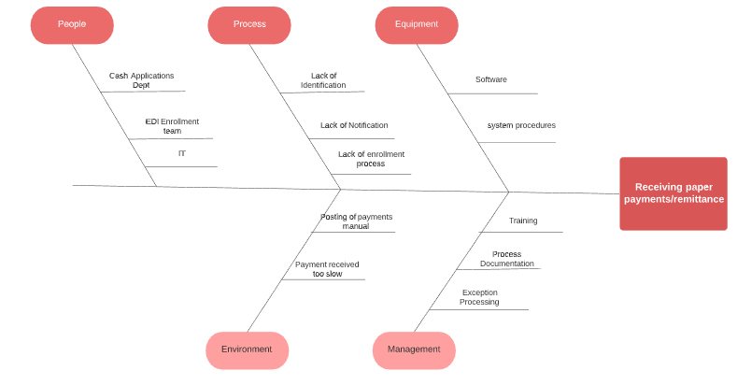
FISHBONE DIAGRAM
KEY CONCEPTS FROM THIS ANALYSIS:
-This analysis provided a comprehensive look at potential issues which offered a chance to prevent certain issues during development
-Although the analysis was narrowed to one of the justifications for the project, the technique applied here was able to be used in other facets such as current systems, workflow, and even team responsibilities.
-Fishbone diagrams allowed us to look at the cause and effect of many components of the system. More practice will give us better results

Slide 9
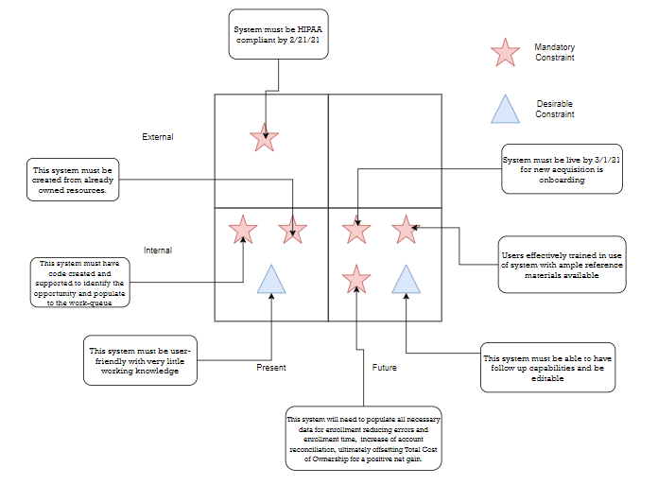
CONSTRAINTS
KEY CONCEPTS FROM THIS ANALYSIS:
-Constraints provide a list of must-have functions of the proposed system both current and future
-In depth fact finding is crucial when trying to gather constraints. All SME’s and key stakeholders need to be interviewed
-Most of the constraints were internal, mainly centered around user experience.
-External entities governing healthcare will always be an external constraint when it comes to dealing with sensitive information

Slide 10
FACT FINDING
While fact finding we obtained the organizational charts pertaining to the teams involved and identified the SME’s, test users and development team. We interviewed the key members to get the necessary details surrounding current processes, systems involved, system and support limitations, and future wants or needs. The gathered and reviewed the documentation of all interviews and systems. We also sent follow-up surveys to EDI and development team managers for additional information on wants vs. needs. Then we conducted a shadow session with the end users to obtain complete understanding of their abilities and potential benefits. WE also documented current process to include turn around time to complete an enrollment and exception processing. The estimated total cost to complete the data gathering and analyzation is set to be less than 20% of budget for this project. The benefits of updating this process and creating the work queue will reduce billing and processing by 70% and increase workers overall moral and production.
KEY CONCEPTS FROM THIS ANALYSIS:
-Input from key stakeholders provides a much better understanding of what the needs of the user/system are.
-Key techniques such as interviews and surveys were critical in ascertaining this info.
-Without taking the time during the preliminary stages of the project, we would have had to trace back and end up reworking a significant portion of the project to include the requirements as per SME’s and Stakeholders.

Slide 11
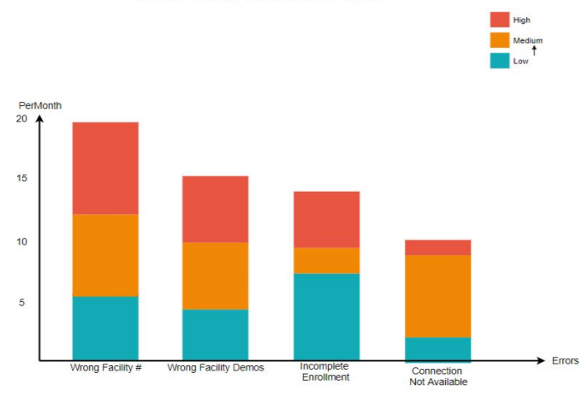
PARETO CHART
KEY CONCEPTS FROM THIS ANALYSIS:
-Pareto charts provide an examination of the frequency of defects and their cumulative impact.
-Allowed us to prioritize specific defects which provided greater insight while planning and developing the project
-Uses the 80/20 rule in that 80 % of the outcome is derived from 20% of the input placing higher value on crucial factors
-We wanted to explore more tools that help analyze and fix defects

Slide 12
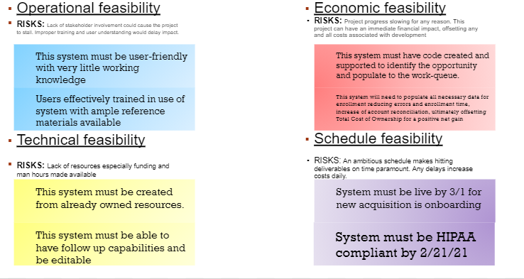
EVALUATE FEASIBILITY
KEY CONCEPTS FROM THIS ANALYSIS:
-Feasibility analysis was extremely useful in allowing the team to objectively evaluate the risks associated with the build
-Constraints and resources were two of the biggest take-aways from this technique in that they had the most impact overall, thus we were able to better anticipate some of the issues moving forward.
-It allowed us to determine that even with some of the possible issues, financially it was almost irresponsible to not have this system in place
-There are other types of feasibility analysis that we wanted to explore further like operational and market

Slide 13
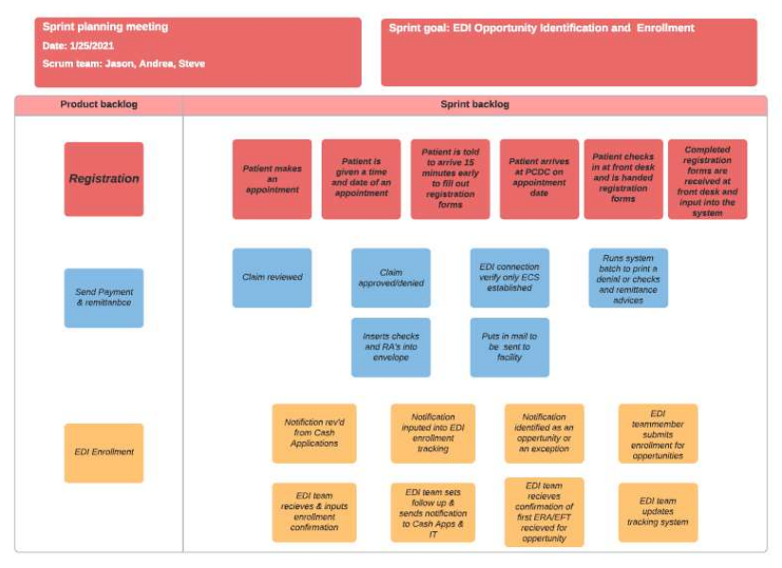
SPRINT PLAN
KEY CONCEPTS FROM THIS ANALYSIS:
-Sprint plans assess factors within the project. Some of these factors include who, what , how, inputs, and outputs.
-We were able to define certain processes regarding how the system will function. Again, it provided an opportunity to examine the workflow of our system in greater detail allowing a more specific plan
-As a team we worked well together. Backlog development was one area that needs to be refined as it is a crucial element of sprint analysis

Slide 14
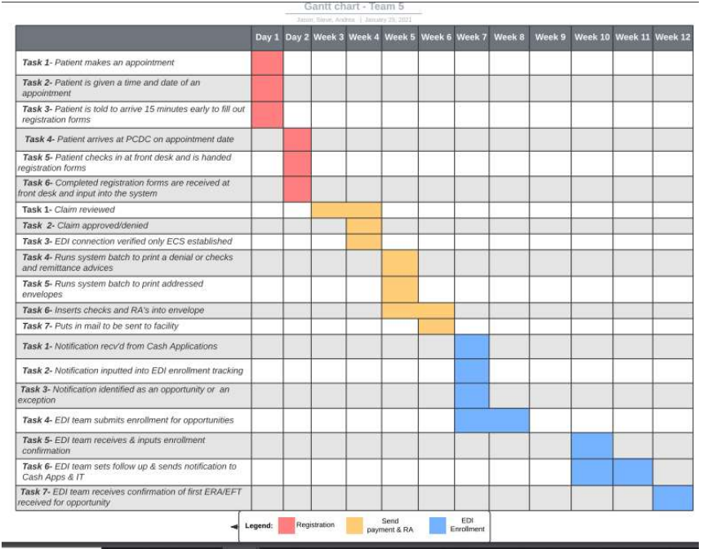
PROJECT PLAN
Holding Week
KEY CONCEPTS FROM THIS ANALYSIS:
-Gantt Charts is a visual representation of the project’s schedule. It allows developers to see relationships between tasks and timeline
-We were able to outline the current process from the time a patient makes an appointment to EDI confirmation
-There is ample software on the market to build Gantt Charts. Without having done any research yet, we wondered which versions offer better results and if there are industry standards when building the charts

Slide 15
REQUIREMENTS MODEL
Input Requirements:
All current accounts will be added to the system
New accounts will be identified and added to the system
Each facility will have all accounts satisfied
Account SME’s have ability to update, modify, and create accounts
Output Requirements:
All new accounts will immediately be flagged for the next step
Processing time for accounts billable will be reduced by 70% upon implementation and 90% within first month
All account information will be up to date
There must be a way to track and report any outstanding accounts
Process Requirements:
The billing department must be able to interface with accounts
The system will handle multiple users in different locations simultaneously
New accounts will be created and tracked immediately
This EDI and the entire and the entire project is scalable
The system will extract billable information at the patient registration
Control Requirements:
Appropriate security measures implemented to mitigate risk of breach
There must be a log of user activity and access
All financial information will be secured and monitored by system manager
The system must be able to recognize different users and their access level
KEY CONCEPTS FROM THIS ANALYSIS:
-Modeling allows for developers to evaluate constraints and requirements. Requirements are broken into different elements of the system and how it functions.
-Our team was able to gain knowledge into the specific details of how our EDI enrollment system will gather, process, and manage system data.
-We examined how departments and external entities communicate and interact with both the current and proposed systems. By defining the requirements, we were able to progress into better overall design.
-There are different types of modeling and even within those types are subtypes. There are also behavior patterns within the modeling that show response of the software to external events. It appears we have only scratched the surface of our understanding or requirements modeling

Slide 16
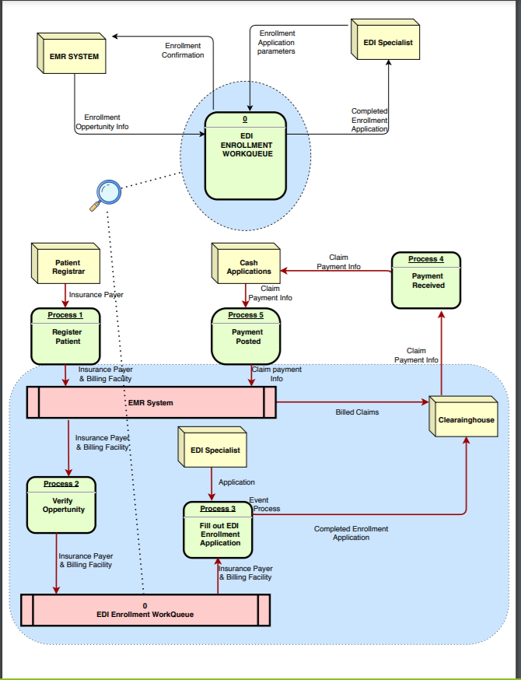
DATA FLOW DIAGRAM
KEY CONCEPTS FROM THIS ANALYSIS:
-DFD’s are graphical representations of the data flow in an information system. There are both logical (data through the system and its functionality) and physical (implementation of data flow)
-Our DFD provided a very specific path that data will follow through the EDI Enrollment system emphasizing the importance of the EDI work queue. It also illustrated the communication between the EDI system and the specialists
-There are so many tools in developing DFDs, but the understanding of the symbols and characters will take time to develop before we can add this as a powerful tool in our careers

Slide 17

UML/ OBJECT MODELS

Slide 18
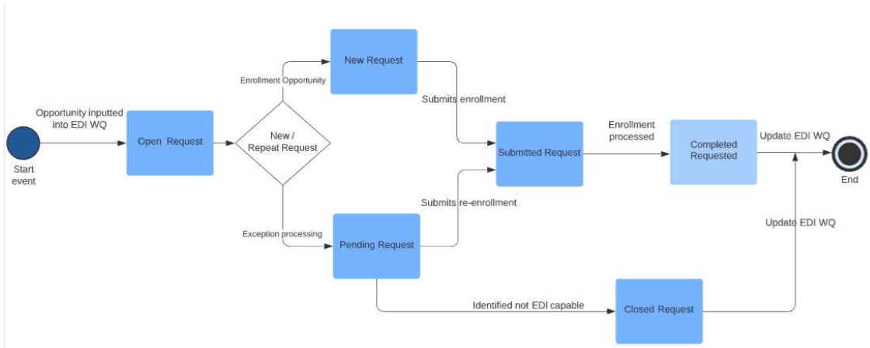
OBJECT MODELS
KEY CONCEPTS FROM THIS ANALYSIS:
-This is the evaluation of events in an object-oriented environment. It is a crucial step in the OOP (object-oriented programming) lifecycle
-This specifically examined how opportunity (start event) initiates the process and ends with updates in the EDI queue. It illustrates what and who makes decisions as these events are raised.
-Overall Object Modeling is a very useful tool in system analysis, and again more practice will lead to better clarity and therefore better modeling analysis. This is too big a concept to assume that this exposure was all encompassing.

Slide 19
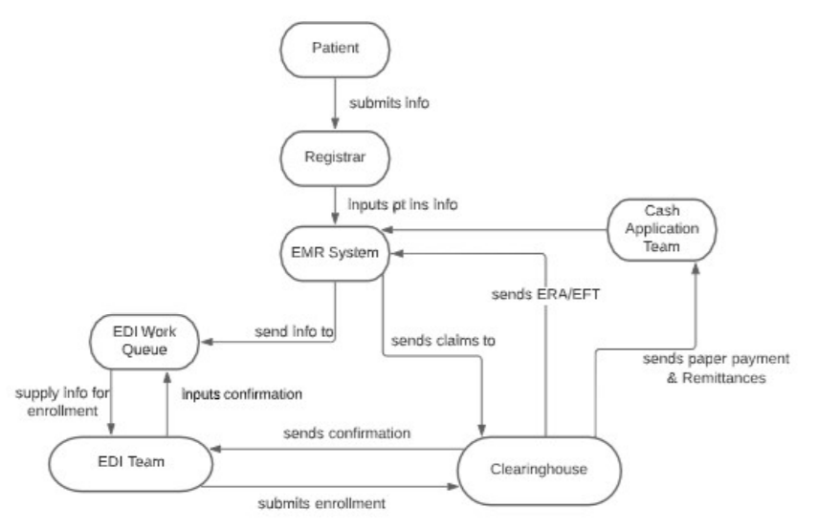
OBJECT RELATIONAL DIAGRAM
KEY CONCEPTS FROM THIS ANALYSIS:
-Object Relational Data Models serve as a bridge between Object-Oriented Models and Relational Database Models so that there is better communication between relational databases and OOP(Object-Oriented Programing)
-We examined the system functionality and how that process works in relation to a complete system. Again, illustrating the communication and transfer of data between all entities.
-What is the difference between ERD (Entity Relationship Diagrams) and object relational data models?

Slide 20
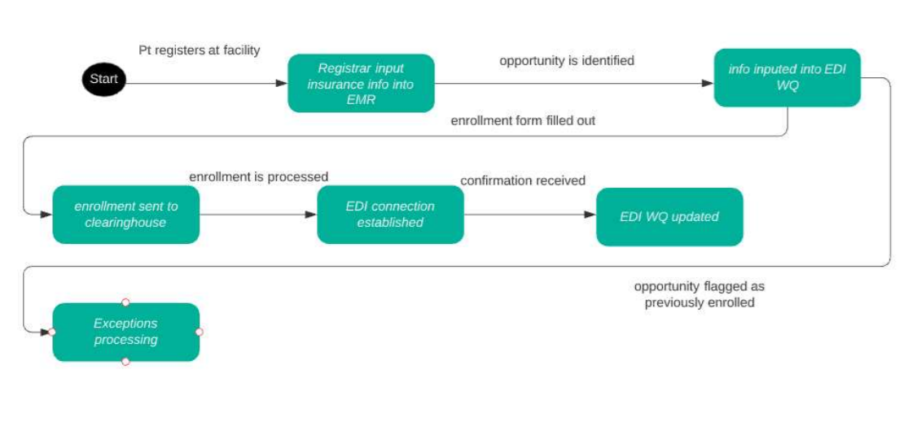
ACTIVITY DIAGRAM
KEY CONCEPTS FROM THIS ANALYSIS:
-Activity diagrams are behavioral diagrams that show how a system behaves. It examines the data flow from a starting point to a termination including decision paths
-Majority of our flow is straight forward, but the decision path at when data enters the queue required some consideration. Ultimately, we were able to pick the system apart and produced a clear understanding of the process this will follow
-We did discuss the comparisons of activity diagrams and use case diagrams. It seems that they overlap or have the potential to overlap quite a bit. Here we would like to pursue more clarity

Slide 21
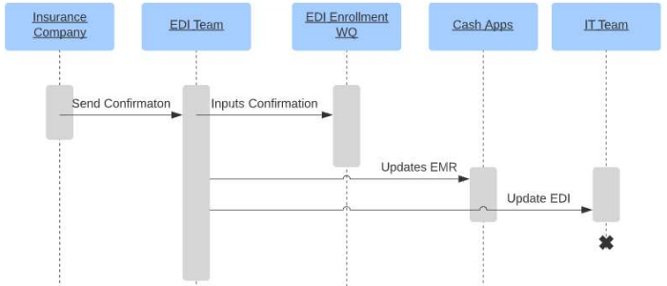
SEQUENCE DIAGRAM
KEY CONCEPTS FROM THIS ANALYSIS:
-Sequence diagrams show how the system responds in relation to time. It depicts the objects/actors and how their flow in relation to the system process happens chronologically
-Although some of this was already discussed with the project plan, this allowed us to focus on the data flow and not the steps of development
-At first glance, these seem simple. How complex do they get and how useful are they in real-world?

Slide 22
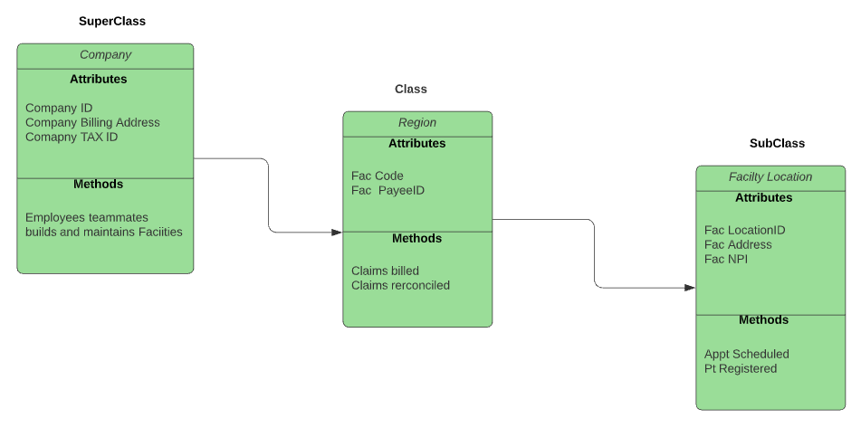
CLASS OBJECT DIAGRAM
KEY CONCEPTS FROM THIS ANALYSIS:
-Object Class Diagrams illustrate a glimpse of the state of a system at a given time. It shows objects and their relationship to other objects
-Our Superclass was the parent company, Class was the region, and Subclass was then the specific location. We were able to visualize the relationships between the classes and how they impact the subsequent class
-One of the biggest questions was where Class and Objects differ. They both show objects and their interactions. Again, concepts that seem to overlap

